Slide 1
Business & professional communication
COVER LETTERS
Dr. KR Kamphoefner

Slide 2
The cover letter
BASICS
Purpose: to say how you are qualitied for a position.
Length: one page
Format: Typed, single-spaced, business letter format
Audience analysis: identify employer’s need; show how you meet that need.
Parts:
Introduction
Body
Conclusion

Slide 3
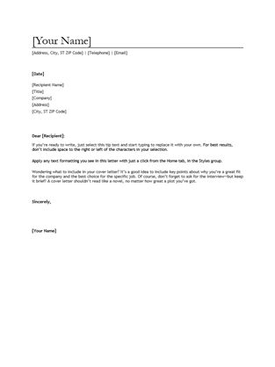
Business letter format
Type: Times New Roman or Calibri
Your address [or letterhead]
Receiver’s address
Subject:
Dear __________:
Paragraphs: no indenting
Justification: left
One line of space between paragraphs
Closing: Sincerely
4 lines
Name
https://templates.office.com/en-us/CV-cover-letter-TM00002060

Slide 4
BODY OF THE LETTER
Body: 2 or 3 paragraphs
background, training, qualifications; why you want to work for them
Relevant accomplishments, related to ad
Your interests, related to company’s needs

Slide 5
CONCLUSION
Conclusion: State that you’d like to come for interview, contact details

Slide 6
Cover letter example
Introduction:
Goals: get attention, encourage employer to keep reading.
Position applying for
Your job objective OR education
Preview: your traits for the job
Body: 2 or 3 paragraphs
background, training, qualifications; why you want to work for them
Relevant accomplishments, related to ad
Your interests, related to company’s needs
Conclusion: State that you’d like to come for interview, contact details
Example, p. 56.

Slide 7
AD
http://www.idealist.org/
http://www.idealist.org/view/job/bbPKD5wW3zh4/

Slide 8
Example cover letter
My Name .
123 Street Address, City, State 111111 emailme@gmail.com +86 151-5432-0987
1 June 2015
Folger Shakespeare Library
201 East Capital Street NW
Washington, DC 20003
Dear Folger Shakespeare Library
With this letter, I would like to apply for the Accountant Assistant position advertised on idealist.org. I have recently completed my BSc in Accounting at Wenzhou-Kean University, a joint Chinese-American university. I loved studying Shakespeare in my English classes, so it would be an honor to work for Folger and its mission of education. I can offer the Folger team a strong work ethic and a passion for accuracy.
I have two years office experience, serving as a student assistant in the Academic Affairs office, in addition to a semester-long internship which gave me practical experience in accounting. I have experience with all levels of jjournal entries, both for cash and credit entries. I also offer excellent database skills. I have used both Datatel and Tessitura. I am adept at using Excel and experienced with both Accounts Receivable and Payable.
My GPA in my Accountancy major is 3.9, indicating my dedication to the profession. I expect to pass the C.P.A. exam this July. While some accountants do not enjoy their work, I am someone who loves numbers and their patterns, which motivate me take pride in my work and give the highest quality service. I also love working with people and am skilled at public speaking, s I would enjoy representing the Folger to clients, donors and the public.
I’m eager to talk with you further abut this opportunity at the Folger Library. Thanks in advance tor considering my qualifications for this position.
Sincerely yours,
My Name

